Slide 1
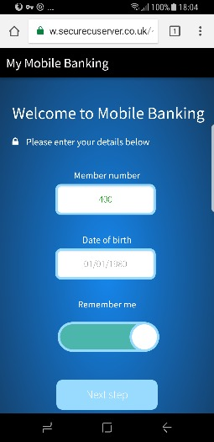
Introducing Silk Curtains
KESHO

Slide 2
Introducing Silk Curtains
The Web App:
KESHO

Slide 3
Introducing Silk Curtains
The Web App:
KESHO
The ONLY Official app for Curtains

Slide 4
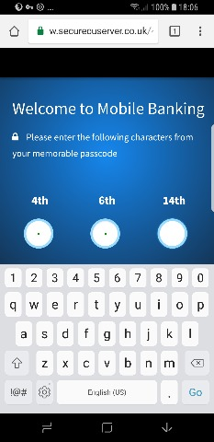
Just register once
Then three
known digits will log you in
KESHO
KESHO

Slide 5
As simple as one, two, three
KESHO
KESHO
KESHO

Slide 6
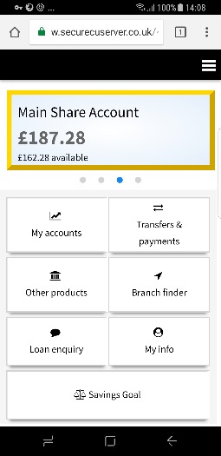
First up – the ‘Home’ screen
KESHO

Slide 7
First up – the ‘Home’ screen
KESHO

Slide 8
Highlighting – My accounts
KESHO
Lets me review all my accounts

Slide 9
Payments and transfers
KESHO
Lets me review all my accounts
Make payments from my account

Slide 10
Illustrating other products
KESHO
Lets me review all my accounts
Make payments from my account
Other accounts I might like

Slide 11
Locating the nearest branch
KESHO
Lets me review all my accounts
Make payments from my account
Other accounts I might like
Find my nearest branch

Slide 12
On-line loan application
KESHO
Lets me review all my accounts
Make payments from my account
Other accounts I might like
Find my nearest branch
I can apply for a loan

Slide 13
Changin addresses on line
KESHO
Lets me review all my accounts
Make payments from my account
Other accounts I might like
Find my nearest branch
I can apply for a loan
Change home and work addresses

Slide 14
Setting savings targets
KESHO
Lets me review all my accounts
Make payments from my account
Other accounts I might like
Find my nearest branch
I can apply for a loan
Change home and work addresses
Set a savings goal

Slide 15
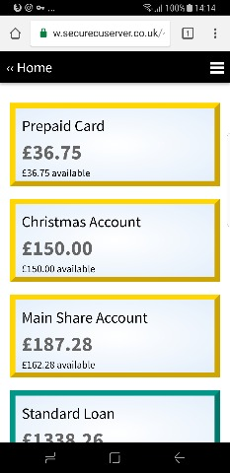
Selecting ‘My accounts’
KESHO
KESHO

Slide 16
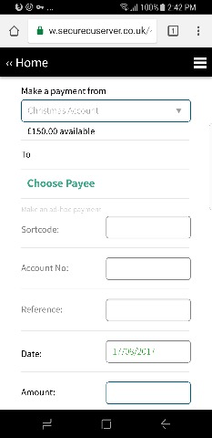
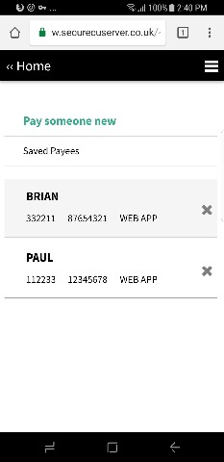
Transfers to stored payees
KESHO
KESHO
KESHO

Slide 17
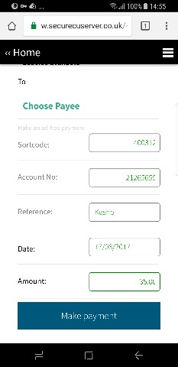
Or making an ‘ad-hoc’ payment
KESHO
KESHO

Slide 18
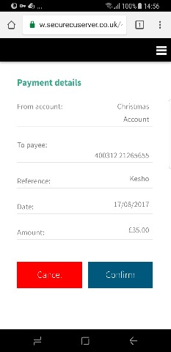
Confirming the details
KESHO
KESHO
KESHO

Slide 19
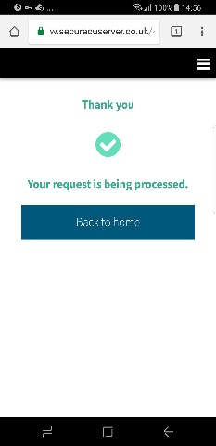
As simple as one, two, three
KESHO
KESHO
KESHO

Slide 20
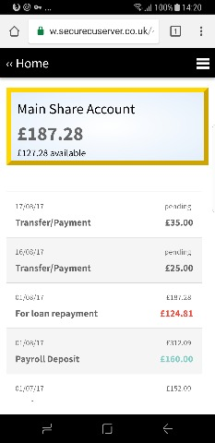
Drilling down - Transactions
KESHO
KESHO

Slide 21
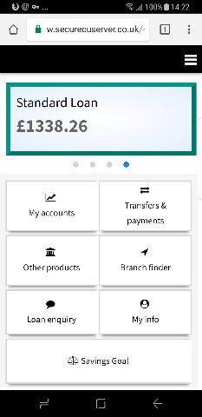
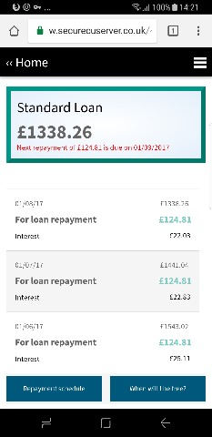
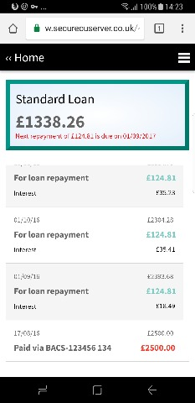
Reviewing your loans
KESHO
KESHO
KESHO

Slide 22
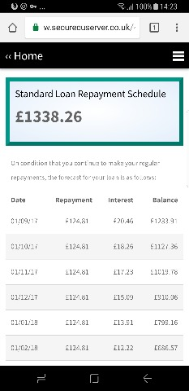
The loan repayment schedule
KESHO
KESHO
KESHO

Slide 23
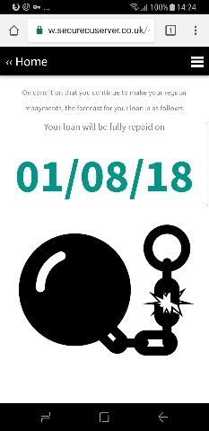
When will I be free?
KESHO
KESHO
KESHO

Slide 24
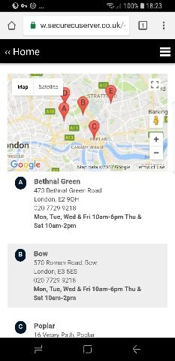
Branch finder
KESHO
KESHO

Slide 25
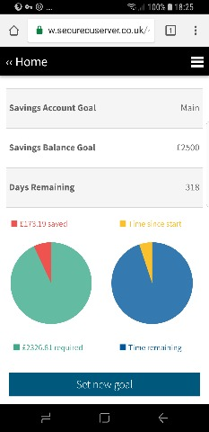
Savings goal(s)
KESHO
KESHO

Slide 26
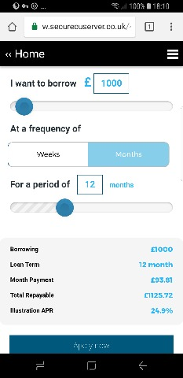
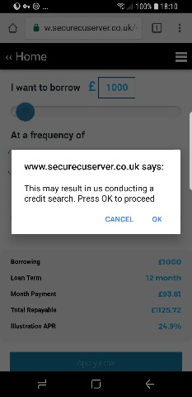
Making a loan application
KESHO
KESHO
KESHO

Slide 27
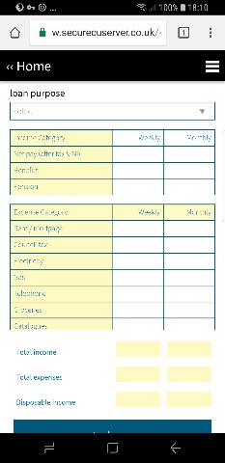
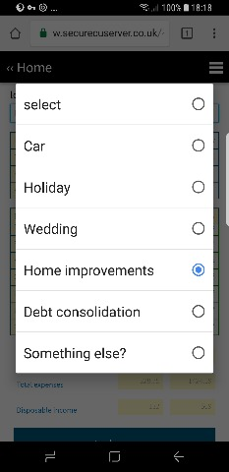
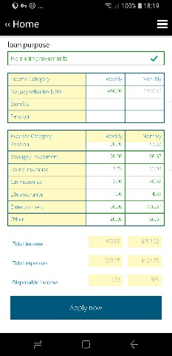
Affordability calculator
KESHO
KESHO
KESHO

Slide 28
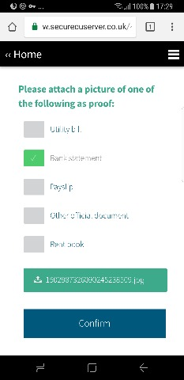
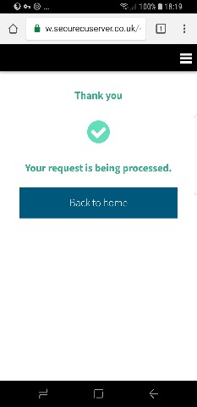
Providing proof of income
KESHO
KESHO
KESHO

Slide 29
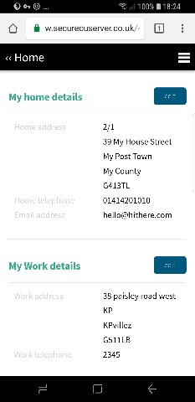
Changing personal details
KESHO
KESHO

Slide 30
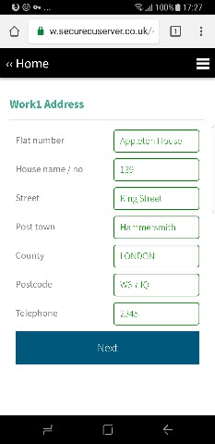
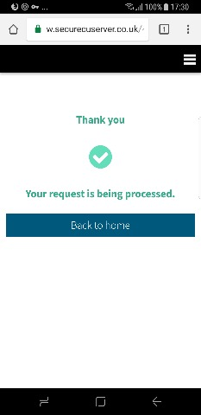
Providing proof of changes
KESHO
KESHO
KESHO

Slide 31
Providing proof of changes
KESHO
KESHO
KESHO

